Slide 1
ARRAYS & CONTROL STRUCTURES
Lecture 4

Slide 2
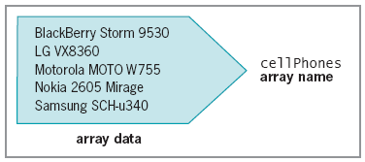
Storing Data in Arrays
Array
  Set of data represented by a single variable name
Figure 1 Conceptual example of an array

Slide 3
Declaring and Initializing Arrays
JavaScript represents arrays with the Array object
  Contains a special constructor named Array()
Constructor
  Special function type used as the basis for creating reference variables
Syntax
  var arrayName = new Array(number of elements);

Slide 4
Declaring and Initializing Arrays (cont’d.)
Example:
  Create an array named cellPhones having 10 elements
    var cellPhones = new Array(10);
Element
  Each piece of data contained in an array
Index
  Element’s numeric position within the array
  Array element numbering
    Starts with index number of zero (0)

Slide 5
Declaring and Initializing Arrays (cont’d.)
Assigning values to individual array elements
  Include the array index for an individual element
Example:
  Assign values to first three elements within the cellPhones array
cellPhones[0] = "BlackBerry Storm 9530"; // first element
cellPhones[1] = "LG VX8360"; // second element
cellPhones[2] = "Motorola MOTO W755"; // third element

Slide 6
Declaring and Initializing Arrays (cont’d.)
Can create an array without any elements
  Add new elements as necessary
  Array size can change dynamically
    cellPhones = new Array();
    cellPhones[2] = "BlackBerry Storm 9530";
Can assign values to elements when array created
    cellPhones = new Array("BlackBerry Storm 9530", "LG VX8360", "Motorola MOTO W755");

Slide 7
Declaring and Initializing Arrays (cont’d.)
Basic rule of thumb
  Only declare number of array elements if exact number of elements the array will store is known
JavaScript values assigned to array elements
  Can be different data types

Slide 8
Accessing Element Information
To access an element’s value:
  Include brackets and element index
Examples:
document.writeln(
cellPhones[0]); // prints "BlackBerry Storm 9530"
document.writeln(
cellPhones[1]); // prints "LG VX8360"
document.writeln(
cellPhones[2]); // prints "Motorola MOTO W755"

Slide 9
Modifying Elements
To modify values in existing array elements
  Include brackets and element index
Can change a value assigned to an array element
Examples:
cellPhones[0] = "BlackBerry Storm 9530"; // first element
cellPhones[1] = "LG VX8360"; // second element
cellPhones[2] = "Motorola MOTO W755"; // third element
cellPhones[0] = "BlackBerry 8830 World Edition";

Slide 10
Determining the Number of Elements in an Array
length property of Array class
  Returns the number of elements in an array
Syntax
  array_name.length;
Example:
cellPhones = new Array();
cellPhones[0] = "BlackBerry Storm 9530"; // first element
cellPhones[1] = "LG VX8360"; // second element
cellPhones[2] = "Motorola MOTO W755"; // third element
document.write("<p>The cell phone array has "
+ cellPhones.length + " elements.</p>");

Slide 11
Making Decisions
Decision making or flow control
  Process of determining the order in which statements execute in a program
Decision-making statements or decision-making structures
  Special types of JavaScript statements used for making decisions
if statement
  Most common type of decision-making statement

Slide 12
if Statements
Used to execute specific programming code
  If conditional expression evaluation returns value of true
Syntax
  if (conditional expression)
    statement;
After the if statement executes:
  Any subsequent code executes normally

Slide 13
if Statements (cont’d.)
var exampleVar = 5;
if (exampleVar == 5) // CONDITION EVALUATES TO 'TRUE'
window.alert("<p>The variable is equal to '5'.</p>");
window.alert("<p>This dialog box is generated after
the if statement.</p>");
var exampleVar = 4;
if (exampleVar == 5) // CONDITION EVALUATES TO 'FALSE'
window.alert("<p>This dialog box will not appear.</p>");
window.alert("<p>This is the only dialog box that
appears.</p>");

Slide 14
if Statements (cont’d.)
Use a command block to construct a decision-making structure containing multiple statements
Command block
  Set of statements contained within a set of braces
  Example:
var exampleVar = 5;
if (exampleVar == 5) { // CONDITION EVALUATES TO 'TRUE‘
  document.write("<p>The condition evaluates to true.</p>");
  document.write("<p><code>exampleVar</code> is equal to 5.</p>");
  document.write("<p>Each of these lines will be printed.</p>");
}
document.write("<p>This statement always executes after the if
  statement.</p>");

Slide 15
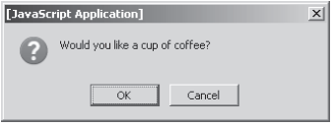
if...else Statements
Executes one action if the condition is true
  And a different action if the condition is false
window.confirm() method
  Displays a confirm dialog box containing an OK button and a Cancel button
  Syntax: window.confirm(message);
  Example:
    window.confirm("Would you like a cup of coffee?");
Figure 2 Confirm dialog box

Slide 16
if...else Statements (cont’d.)
Syntax for an if . . . else statement
if (conditional expression)
statement;
else
statement;

Slide 17
if...else Statements (cont’d.)
Can use command blocks to construct an if...else statement
Syntax
if (conditional expression) {
statements;
}
else {
statements;
}

Slide 18
if...else Statements (cont’d.)
Example:
var today = "Tuesday"
if (today == "Monday")
document.write("<p>Today is Monday</p>");
else
document.write("<p>Today is not Monday</p>");

Slide 19
Nested if and if...else Statements
Nested decision-making structures
  One decision-making statement contains another decision-making statement
Nested if statement
  An if statement contained within an if statement or within an if...else statement
Nested if...else statement
  An if...else statement contained within an if statement or within an if...else statement

Slide 20
Nested if and if...else Statements (cont’d.)
Example:
var salesTotal = window.prompt("What is the sales total?", 0);
if (salesTotal > 50)
if (salesTotal < 100)
document.write("<p>The sales total is between 50 and 100.</p>");

Slide 21
Nested if and if...else Statements (cont’d.)
window.prompt() method
  Displays a prompt dialog box with a message, a text box, an OK button, and a Cancel button
  Any text entered into a prompt dialog box by a user can be assigned to a variable
  Syntax
    variable = window.prompt
    (message, default text);

Slide 22
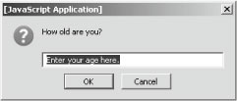
Nested if and if...else Statements (cont’d.)
Example:
  var yourAge = window.prompt("How old are you?", "Enter your age here.");
Figure 3 Prompt dialog box

Slide 23
switch Statements
Controls program flow by executing a specific set of statements
    Dependent on an expression value
Compares expression value to value contained within a case label
case label
  Represents a specific value
  Contains one or more statements that execute:
    If case label value matches the switch statement’s expression value

Slide 24
switch Statements (cont’d.)
Syntax
switch (expression) {
case label:
statement(s);
case label:
statement(s);
. . .
default:
statement(s);
}

Slide 25
switch Statements (cont’d.)
Example: case labels
case exampleVar: // variable name
statement(s)
case "text string": // string literal
statement(s)
case 75: // integer literal
statement(s)
case -273.4: // floating-point literal
statement(s)

Slide 26
switch Statements (cont’d.)
default label
  Executes when the value returned by the switch statement expression does not match a case label
When a switch statement executes:
  Value returned by the expression is compared to each case label
    In the order in which it is encountered
break statement
  Used to exit a control structure

Slide 27
switch Statements (cont’d.)
function city_location(americanCity) {
switch (americanCity) {
case "Boston":
return "Massachusetts";
break;
case "Chicago":
return "Illinois";
break;
case "Los Angeles":
return "California";
break;
case "Miami":
return "Florida";
break;
case "New York":
return "New York";
break;
default:
return "United States";
}
}
document.write("<p>" + city_location("Boston")
+ "</p>");

Slide 28
Repeating Code
Loop statement
  Control structure repeatedly executing a statement or a series of statements
    While a specific condition is true or until a specific condition becomes true
Three types of loop statements
  while statements
  do...while statements
  for statements

Slide 29
while Statements
while statement
  Repeats a statement or series of statements
    As long as a given conditional expression evaluates to true
Syntax
      while (conditional expression) {
      statement(s);
      }
Iteration
  Each repetition of a looping statement

Slide 30
while Statements (cont’d.)
Counter
  Variable incrementing or decrementing with each loop statement iteration
Examples:
  while statement using an increment operator
  while statement using a decrement operator
  while statement using the *= assignment operator

Slide 31
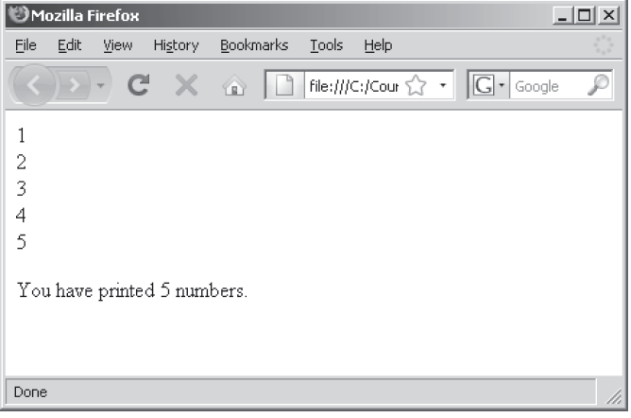
while Statements (cont’d.)
var count = 1;
while (count <= 5) {
document.write(count + "<br />");
++count;
}
document.write("<p>You have printed 5 numbers.</p>");
Figure 3 Output of a while statement using an increment operator

Slide 32
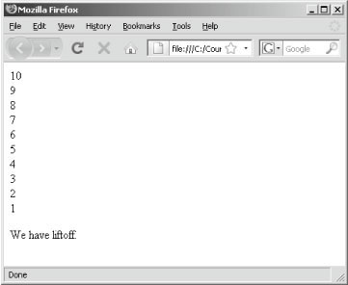
while Statements (cont’d.)
var count = 10;
while (count > 0) {
document.write(count + "<br />");
--count;
}
document.write("<p>We have liftoff.</p>");
Figure 4 Output of a while statement using a decrement operator

Slide 33
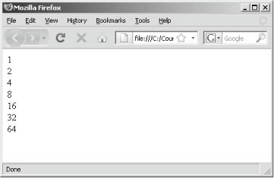
while Statements (cont’d.)
var count = 1;
while (count <= 100) {
document.write(count + "<br />");
count *= 2;
}
Figure 5 Output of a while statement using the *= assignment operator

Slide 34
while Statements (cont’d.)
Infinite loop
  Loop statement that never ends
    Conditional expression: never false
  Example:
var count = 1;
while (count <= 10) {
window.alert("The number is " + count + ".");
}

Slide 35
for Statements
for statement
  Repeats a statement or series of statements
    As long as a given conditional expression evaluates to true
  Can also include code that initializes a counter and changes its value with each iteration
Syntax
for (counter declaration and initialization; condition;update statement) {
statement(s);
}

Slide 36
for Statements (cont’d.)
Steps when JavaScript interpreter encounters a for loop
  1. Counter variable declared and initialized
  2. for loop condition evaluated
  3. If condition evaluation in Step 2 returns value of true:
    for loop statements execute, Step 4 occurs, and the process starts over again with Step 2
  If condition evaluation in Step 2 returns value of false:
    for statement ends
    Next statement following the for statement executes
  4. Update statement in the for statement executed

Slide 37
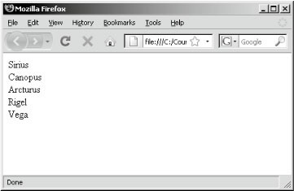
for Statements (cont’d.)
var brightestStars = new Array();
brightestStars[0] = "Sirius";
brightestStars[1] = "Canopus";
brightestStars[2] = "Arcturus";
brightestStars[3] = "Rigel";
brightestStars[4] = "Vega";
for (var count = 0; count < brightestStars.length; ++count) {
document.write(brightestStars[count] + "<br />");
}
Figure 6 Output of brightest stars script

Slide 38
for Statements (cont’d.)
for statement
  Some say more efficient than a while statement
  Readability better in for loop
Examples:
var count = 1;
while (count < brightestStars.length) {
document.write(count + "<br />");
++count;
}
for (var count = 1; count < brightestStars.length; ++count) {
document.write(count + "<br />");
}

Slide 39
for Statements (cont’d.)
Example:
  Days of Week script with a for statement
var daysOfWeek = new Array();
daysOfWeek[0] = "Monday"; daysOfWeek[1] = "Tuesday";
daysOfWeek[2] = "Wednesday"; daysOfWeek[3] = "Thursday";
daysOfWeek[4] = "Friday"; daysOfWeek[5] = "Saturday";
daysOfWeek[6] = "Sunday";
for (var count = 0; count < daysOfWeek.length; ++count) {
document.write(daysOfWeek[count] + "<br />");
}

Slide 40
Using CONTINUE Statements to Restart Execution
continue statement
  Halts a looping statement
    Restarts the loop with a new iteration
  Used to stop a loop for the current iteration
    Have the loop to continue with a new iteration
Examples:
  for loop with a continue statement
  for loop with a break statement

Slide 41
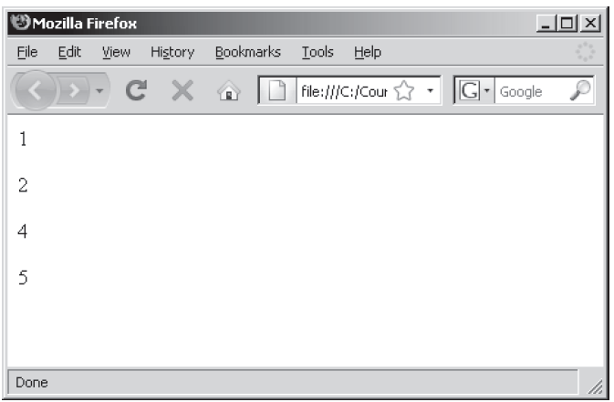
Using CONTINUE Statements to Restart Execution (cont’d.)
for (var count = 1; count <= 5; ++count) {
if (count == 3)
continue;
document.write("<p>" + count + "</p>");
}
Figure 7 Output of a for loop with a
continue statement

Slide 42
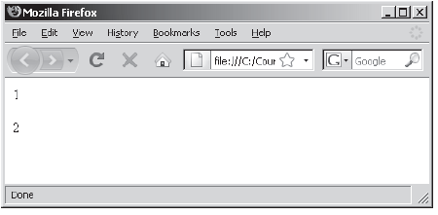
Using CONTINUE Statements to Restart Execution (cont’d.)
for (var count = 1; count <= 5; ++count) {
if (count == 3)
break;
document.write("<p>" + count + "</p>");
}
Figure 8 Output of a for loop with a break statement

